Slide 1
Federated Explainable Hierarchical Imitation Learning (FEHIL)
Harry Field
Supervised by Dandan Zhang

Slide 2
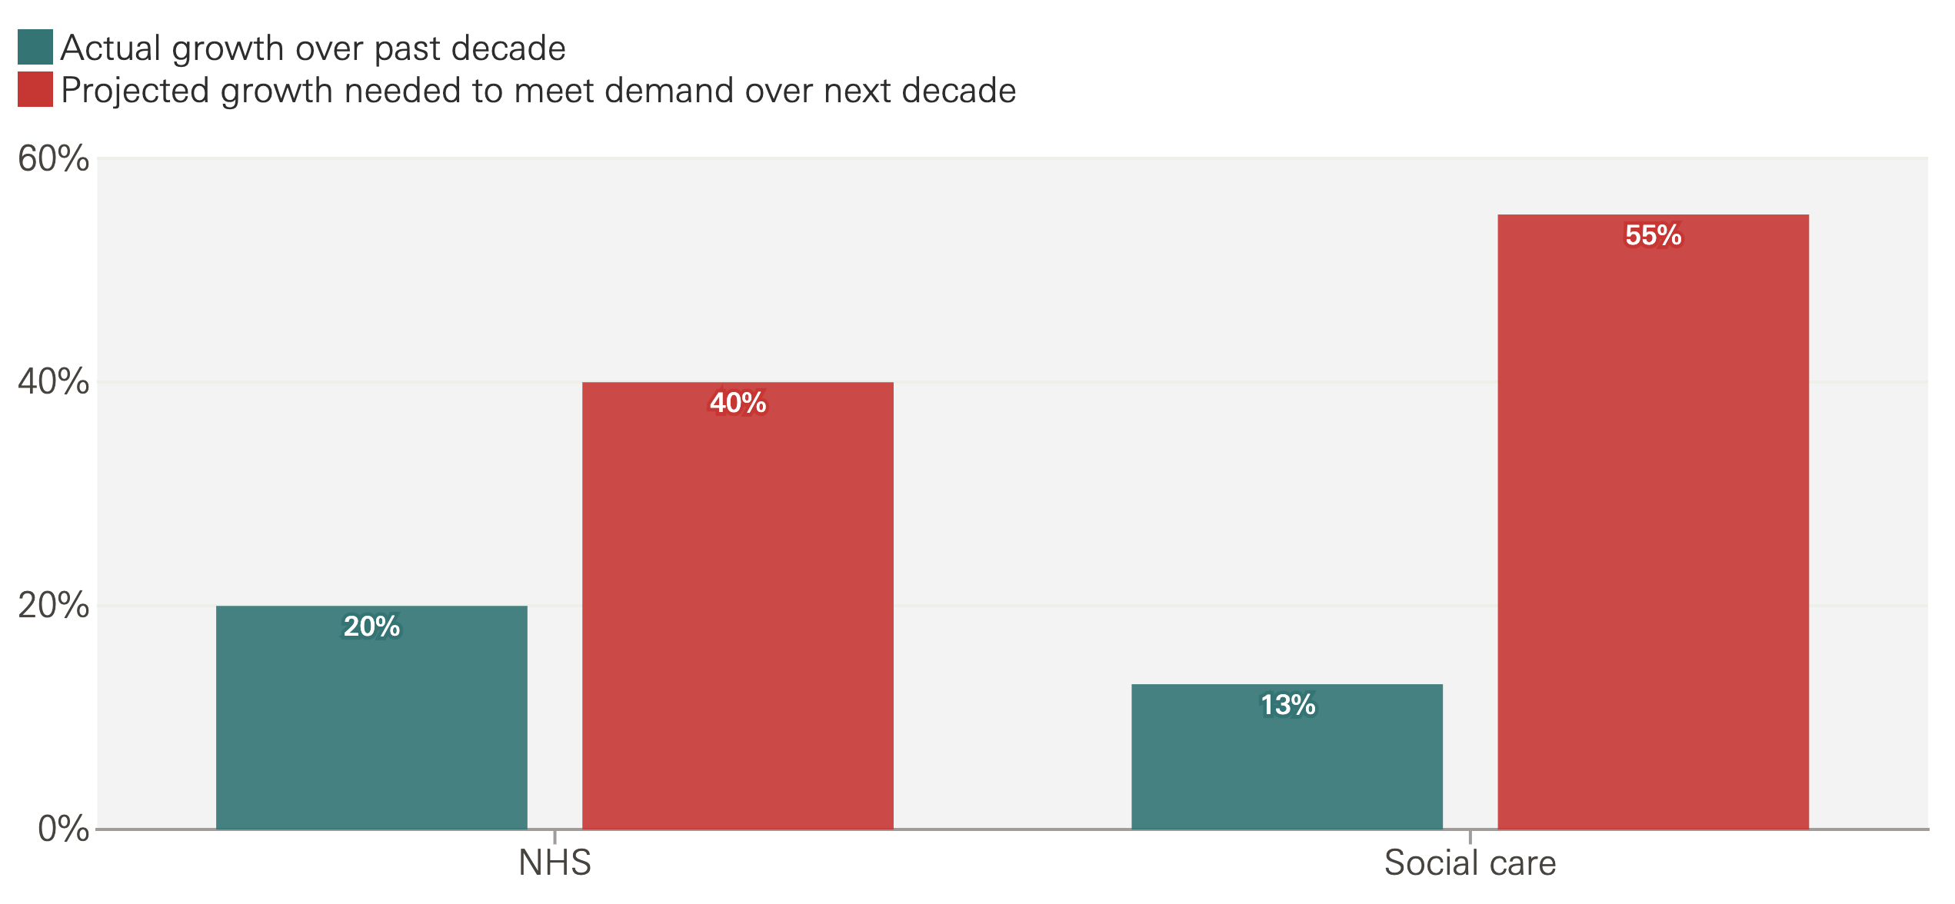
Motivation
Care staffing crisis – robotics could assist in providing care
Performing everyday physical tasks has potential to improve patient independence
Systems can continue to improve with patient data post deployment
Data privacy and explainability present barriers to adoption
Set out to create a homecare robotics framework imbued with explainability and privacy from the start
Figure: https://www.health.org.uk/news-and-comment/charts-and-infographics/how-much-does-the-nhs-and-social-care-workforce-need-to-grow
Notes:
- Motivating this project is the ongoing care staffing crisis and the barriers to adopting robotics technology in care scenarios
- If suitable assistance robotics solutions can be presented in the home, patients may be able to maintain independence where they might otherwise require formal care
- One thing that can improve the behaviour of AI homecare Robotics systems is access to user data, as this more closely approximates the true distribution of data the system will encounter compared to controlled lab settings
- In the context of patient care, however, this data is sensitive. With current legislation unclear on the rules surrounding this data, it seems pertinent to prioritise patient data privacy
- Continued R&D in this area could empower patients in managing their own data assets.
Data privacy – EU law is unclear
https://www.health.org.uk/news-and-comment/charts-and-infographics/how-much-does-the-nhs-and-social-care-workforce-need-to-grow

Slide 3
Project Aims
Propose a hybrid algorithm combining federated learning with imitation learning for robotic manipulation
Evaluate performance of proposed algorithm against example imitation learning approach
Identify IL Method
Establish Benchmark
Integrate FL
Compare & Evaluate
Notes:
- To Propose a hybrid algorithm combining federated learning with imitation learning for robotic manipulation
- Federated Learning is well suited to this project’s motivations, as it could enable learning from patient data that is never shared with a central server. (this circumvents many of the concerns surrounding sensitive patient data)
- To better understand the trade-offs between data privacy and performance in robotic systems, I sought to find a suitable imitation learning framework which FL could be applied to
- Through this, benchmark results could be obtained for comparison and evaluation when FL is implemented on top

Slide 4
Approach
Explainable Hierarchical Imitation Learning (EHIL) is chosen as an example of XAI in robotic manipulation
Explore the effects of applying Federated Learning to EHIL
FEHIL algorithm is proposed to imbue XAI with privacy preservation
By conducting training on both EHIL and FEHIL with the same data, direct comparisons can be made from which to draw conclusions
FEHIL
Data Privacy
Explainability
Homecare Robotics
Notes:
- EHIL was chosen as an example of XAI in robotic manipulation, from which the effects of FL could be explored
- By applying FL to EHIL, I propose the FEHIL algorithm, which combines the features of EHIL and FL into a cohesive algorithm
- In doing this, the effects of applying FL can be directly compared against the non-federated case
- From these results, conclusions can be drawn

Slide 5
Federated Learning
Central Server
Aggregation Fn
Global Model
Client 1
Client 2 …
… Client c
Private Data
Private Data
Private Data
Global Model
Global Model
Global Model
Fine Tuned Model
Fine Tuned Model
Fine Tuned Model
Notes:
- This is a representation of federated learning, which is comprised of a single central server and many clients
- Each of these separate clients can be thought of as one assistive robot, where each robot can do some model training locally on the data they get interacting with their patient, and upload the model weights to the central server where they are aggregated into the next rounds global model
- By doing it this way, communication costs are reduced, compute resources are distributed to the patients, and patient data is never shared with the central server.
- so that’s federated learning
- now we’re going to talk about EHIL

Slide 6
Explainable Hierarchical Imitation Learning (EHIL)
An example of XAI in care robotics we can supplement with privacy-preserving techniques
We use robotic pouring as the example task
Imitation Learning (Behavioural Cloning) forms the control
Two Image Classifiers form the explanation of the control decisions
The explanation is conveyed in a logical graph

Slide 7
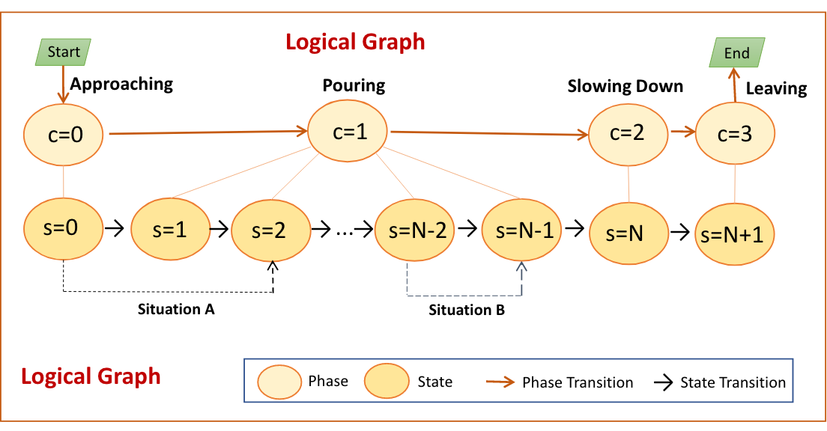
EHIL Logical Graph
Hierarchy 1
Hierarchy 2
RGB
Video
Frames
Hierarchy 3
Angle of pour
Figure: Zhang, Dandan, et al. "Explainable hierarchical imitation learning for robotic drink pouring.”
IEEE Transactions on Automation Science and Engineering 19.4 (2021): 3871-3887.
Notes:
- The logical graph forms the explanation of the model in simple terms which convey the model’s progress through the task
- The separate hierarchies refer to the hierarchies of the task representation, as well as individual models.
- H1 and H2 are classifiers, which given a video frame will classify the task progress into a phase and state
- We can see that in the robotic pouring example, the phases are approaching, pouring, slowing down and leaving, but these can be altered to suit the task being performed
- H3 is a regression model, forming the robot control, so H1 and H2 explain the action determined by H3

Slide 8
Imitation Learning: Behavioural Cloning
Behaviour: Human demonstration by teleoperation
RGB Video of teleoperated arm
+
Angle of pour at each video frame
Cloning: Supervised learning
RGB Frame 1
Angle of Pour 1
…
ResNet
…
RGB Frame n
Angle of Pour n
Notes:
- Briefly looking at behavioural cloning, it essentially works like supervised learning
- The Behaviour observations form the training data, and the cloning process uses this data to train a model
- Moving on from this, we know we have 3 hierarchies…

Slide 9
Federated Explainable Hierarchical Imitation Learning
Central Server
Hierarchy Architecture
Aggregation Fn
Global Model
Client 1
Client 2
Client c
Private Data
Private Data
Private Data
Global Model
Global Model
Global Model
Fine Tuned Model
Fine Tuned Model
Fine Tuned Model
Notes:
- So if we imagine we are conducting FL on one hierarchy for a moment, we would use the hierarchy architecture for the server model as well as the client models
- For the dataset…

Slide 10
Original Data
Demo 1 |  |  |  | Demo 2 |  |  |  | Demo … |  |  |  | Demo d
Frame 1 | Phase | State | Angle | Frame 1 | Phase | State | Angle | Frame 1 | Phase | State | Angle | Frame 1 | Phase | State | Angle
Frame 2 | Phase | State | Angle | Frame 2 | Phase | State | Angle | Frame 2 | Phase | State | Angle | Frame 2 | Phase | State | Angle
Frame … | Phase | State | Angle | Frame … | Phase | State | Angle | Frame … | Phase | State | Angle | Frame … | Phase | State | Angle
Frame 1n | Phase | State | Angle | Frame 2n | Phase | State | Angle | Frame …n | Phase | State | Angle | Frame dn | Phase | State | Angle
Notes:
- I was able to separate the data used in the EHIL paper by the teleoperated demonstrations
- you can imagine that the data was originally something like this
- and then to convert it to federated data…

Slide 11
Federated Data
Client 1
Client 2
Client …
Client c
Demo 1 |  |  |  | Demo 2 |  |  |  | Demo … |  |  |  | Demo d
Frame 1 | Phase | State | Angle | Frame 1 | Phase | State | Angle | Frame 1 | Phase | State | Angle | Frame 1 | Phase | State | Angle
Frame 2 | Phase | State | Angle | Frame 2 | Phase | State | Angle | Frame 2 | Phase | State | Angle | Frame 2 | Phase | State | Angle
Frame … | Phase | State | Angle | Frame … | Phase | State | Angle | Frame … | Phase | State | Angle | Frame … | Phase | State | Angle
Frame 1n | Phase | State | Angle | Frame 2n | Phase | State | Angle | Frame …n | Phase | State | Angle | Frame dn | Phase | State | Angle
Notes:
- it was separated like this
- so now we have a separate dataset per client

Slide 12
Federated Explainable Hierarchical Imitation Learning
Central Server
Hierarchy Architecture
Aggregation Fn
Global Model
Client 1
Client 2
Client c
Demo 1
Demo 2
Demo d
Global Model
Global Model
Global Model
Fine Tuned Model
Fine Tuned Model
Fine Tuned Model
Notes:
- Which would fit into the FL framework like this
- Keeping all data separate

Slide 13
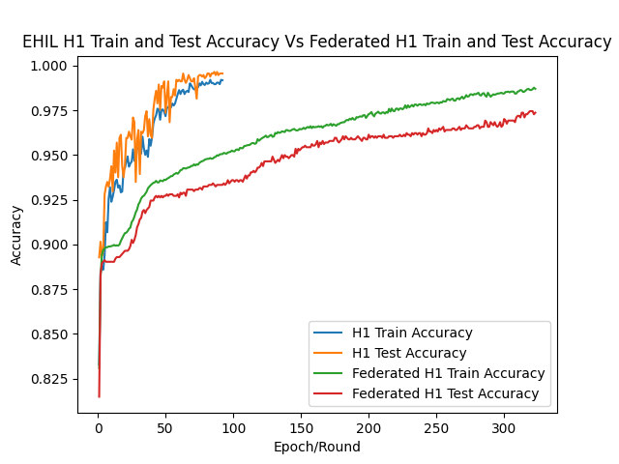
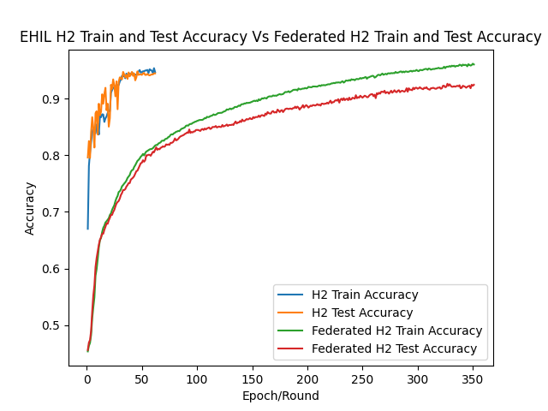
Results: H1, H2 Accuracy
Notes:
- Here we compare the accuracy of EHIL with FEHIL for H1 and H2
- The red line represents the test accuracy in the federated case
- we can see that similar results are obtained, but they are not quite equal and FEHIL takes longer to converge
EHIL H1 was 0.996, FEHIL was 0.975
EHIL H2 was 0.945, FEHIL was 0.925

Slide 14
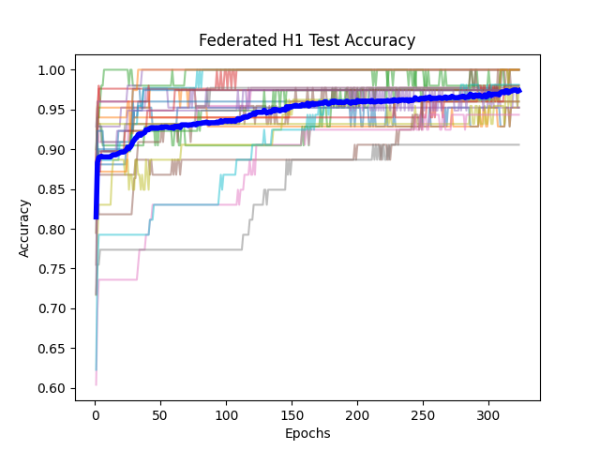
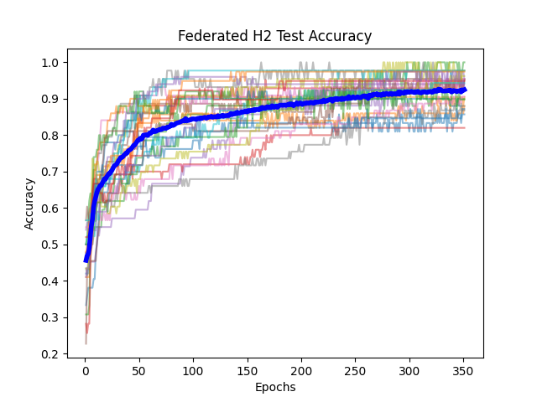
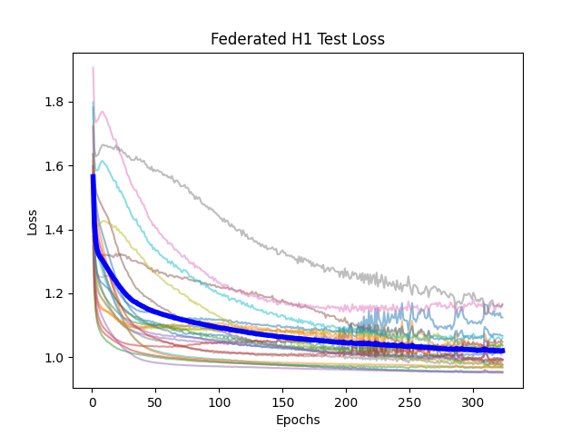
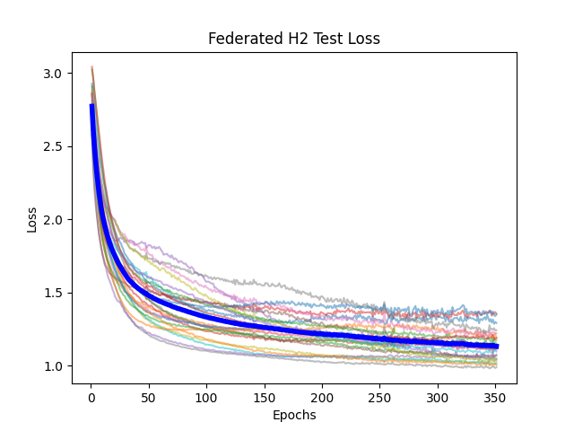
Results: H1, H2 Accuracy
Notes:
- Looking at just the federated case across all the clients, we can see minimal signs of forgetting throughout training until the model starts to converge
- this is only trained with one epoch per client per training round, so the models don’t have a great deal of opportunity to diverge.
- We would expect this noise to increase as we increase the number of epochs per round
- And this represents something to consider when it comes to the implementation of FL, as a reduction in local performance through training would discourage client participation
- While it seems that the loss is converging satisfactorily here, comparing the global loss to the EHIL approach…

Slide 15
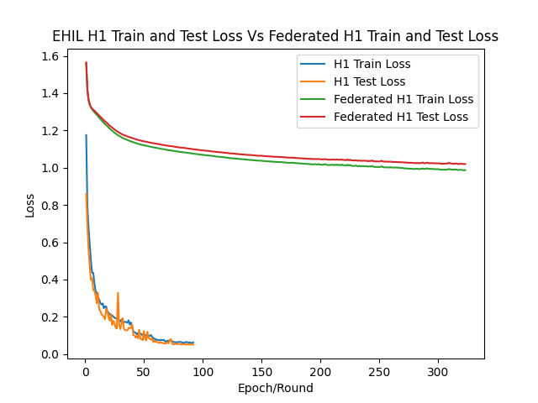
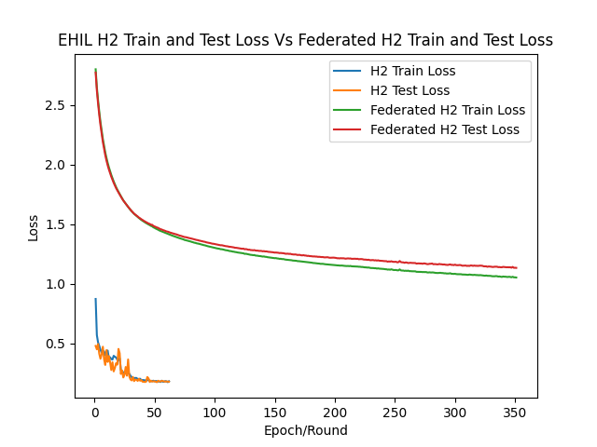
Results: H1, H2 Categorical Cross Entropy
Notes:
- Reveals that the loss is actually far worse than the non federated case
- This is likely due to the nature of categorical cross entropy, where even though the accuracy (obtained through the chosen class) is comparable, the distribution of probability amongst the classes is very noisy
- This noise might be caused by the diversity of local datasets forming a rugged optimisation landscape
- This affects the accuracy of H2 more than H1, possibly due to more classes

Slide 16
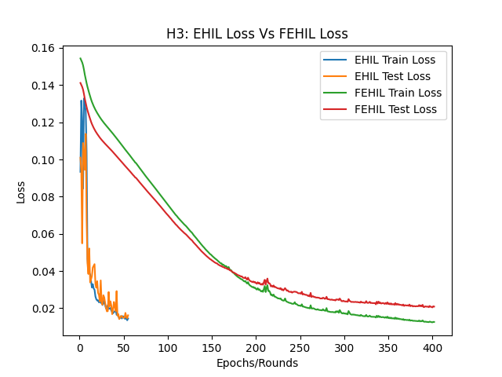
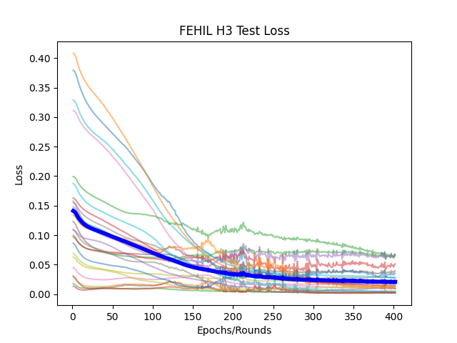
Results: H3
Notes:
- Looking at H3 now (the regression case), we see much the same behaviour as before, without the increased noise as the model converges
- But unlike the EHIL experiments, the regression case took the longest to converge
Finished at 0.021 compared to EHIL at 0.016

Slide 17
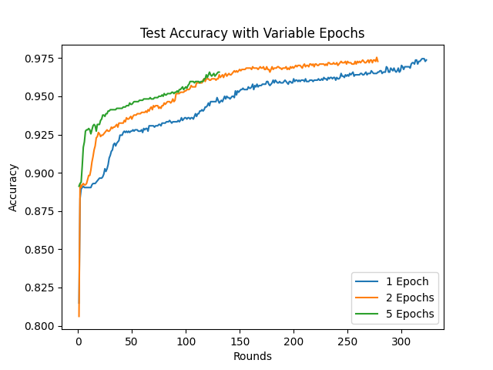
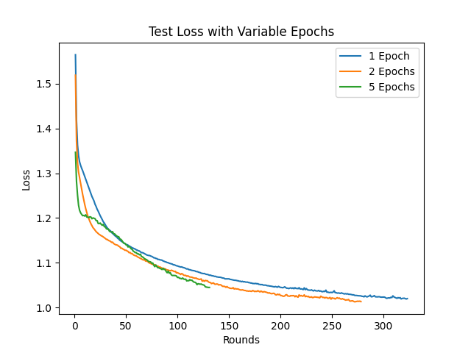
Results: H1 Variable Epochs per Round
Notes:
- Since submitting my report, I have been able to run some more experiments where the number of epochs per client per training round has been varied
- This means that in each round of communication, each client performed more epochs of training than the single epoch we have seen so far
- Due to the computational overhead of running these experiments, I haven’t been able to fully explore the effects of continually increasing epochs through the various hierarchies
- However, we can see here that the effect appears to show faster convergence, with a reduction in performance
Requires much higher compute resources
1: 0.974
2: 0.973
5: 0.966

Slide 18
Conclusion & Future Work
FEHIL can achieve comparable results to the non-federated setting
FL is a suitable privacy preserving technique for AI-governed homecare robotics, but takes much longer to converge (in this experiment)
Data Distribution could be better
Catastrophic Forgetting could be a barrier to client participation
Hyperparameter Tuning could evoke greater performance
Alternative XAI and Control frameworks would be better suited to FL
Notes:
- From these experiments, we can conclude that FEHIL can achieve comparable results to the non-federated setting
- FL presents a suitable solution for homecare robotics in that the compromise on performance is minimal, but it does take much longer to converge
- Where our experiments are limited, we can see areas for future work.
- More data, from a more varied distribution, would further inform the effects of FL on the model’s ability to converge and the emergence of forgetting
- Lifelong learning techniques could be explored to prevent forgetting through the training process, encouraging continued client participation
- hyperparameter tuning would reveal the framework’s true potential
- Alternative learning techniques that do not require the manual labelling of data might make user data more valuable to the training process
- And finally, while these results are encouraging, they would require measurement in simulation and online to confirm the validity of the global model.

